Slide 1
PM9A1 FW Change Notification
2022. Aug
Memory Business, Quality Assurance Division
THIS DOCUMENT AND ALL INFORMATION PROVIDED HEREIN (COLLECTIVELY, “INFORMATION”) IS PROVIDED ON AN “AS IS” BASIS AND REMAINS THE SOLE AND EXCLUSIVE PROPERTY OF SAMSUNG ELECTRONICS CO., LTD. CUSTOMER MUST KEEP ALL INFORMATION IN STRICT CONFIDENCE AND TRUST, AND MUST NOT, DIRECTLY OR INDIRECTLY, IN ANY WAY, DISCLOSE, MAKE ACCESSIBALE, POST ON A WEBSITE, REVEAL, REPORT, PUBLISH, DISSEMINATE OR TRANSFER ANY INFORMATION TO ANY THIRD PARTY. CUSTOMER MUST NOT REPRODUCE OR COPY INFORMATION, WITHOUT SPECIFIC WRITTEN CONSENT FROM SAMSUNG. CUSTOMER MUST NOT USE, OR ALLOW USE OF, ANY INFORMATION IN ANY MANNER WHATSOEVER, EXCEPT FOR CUSTOMER’S INTERNAL EVALUATION PURPOSE. CUSTOMER MUST RESTRICT ACCESS TO INFORMATION TO THOSE OF ITS EMPLOYEES WHO HAVE A BONA FIDE NEED-TO-KNOW FOR SUCH PURPOSE AND ARE BOUND BY OBLIGATIONS AT LEAST AS RESTRICTIVE AS THIS CLAUSE. BY RECEIVING THIS DOCUMENT, IT IS UNDERSTOOD THAT CUSTOMER AGREES TO THE FOREGOING AND TO INDEMNIFY SAMSUNG FOR ANY FAILURE TO STRICTLY COMPLY THEREWITH. IF YOU DO NOT AGREE TO ANY PORTION OF THIS CLAUSE, PLEASE RETURN ALL INFORMATION AND ALL COPIES (IF ANY) WITHIN 24 HOURS OF RECEIPT THEREOF.

Slide 2
Contents
FW Change List
Change List
Samsung Qualification Schedule
Affected Product
Detailed of Change

Slide 3
FW Change List
Purpose : Samsung PM9A1 NVMe SSD F/W Change
Reason of change
Samsung would like to improve the FW quality through fixing the problem
Samsung internal schedule
Samsung internal Qualification : ~ Aug 22
Release schedule : Aug 24

Slide 4
FW Change List (1)
FW change List
Samsung would like to improve FW Quality through FW Change notification.
No. | Item | Change item | Risk Assessment
1 | Improve FA debug feature | Support UART feature Adding debug logging feature | Low
2 | added FW W/A to improve AFC circuit malfunction of CTRL | - Add 2 times AFC circuit retry code when AFC circuit work abnormally If AFC circuit work abnormally, the FW initializes AFC circuit after 10ms and 15ms | Low
3 | Optimized Unmap range | - # of LPN per Unmap Range needs change : Total # of LPN per Device (GXA7402Q) -> 1000 (GXA7602Q) -> 10000 (GXA7702Q) | Low
4 | Fix FW - SLC compaction victim block | When exit PM( power management mode), FW only check whether the F/G SSB Compaction Victim exists and do not remove it from the list( Fixed FW ) | Low
5 | Fixed LTR Latency value Register Structure | (Device internal) Register Mapping of FW Header is fixed. - It is affected to below Message TLP. Register mapping related to Snoop/No-snoop latency of device FW Header was reversed. - [R←][Msg][LTR][Snoop : --][No-snoop : --] | Low

Slide 5
Affected product
PM9A1 P/N & New FW information
Product | Density | Samsung P/N | Current Firmware | New Firmware
M.2 (SED) | 256GB | MZVL2256HCHQ-00B07 | GXA7602Q | GXA7702Q
 | 512G | MZVL2512HCJQ-00B07
 | 1TB | MZVL21T0HCLR-00B07
 | 2TB | MZVL22T0HBLB-00B07 | GXB7602Q | GXB7702Q
M.2 (non SED) | 256GB | MZVL2256HCHQ-00A00 | GXA7601Q | GXA7701Q
 |  | MZVL2256HCHQ-00B00
 | 512G | MZVL2512HCJQ-00A00
 |  | MZVL2512HCJQ-00B00
 | 1TB | MZVL21T0HCLR-00A00
 |  | MZVL21T0HCLR-00B00
 | 2TB | MZVL22T0HBLB-00A00 | GXB7601Q | GXB7701Q
 |  | MZVL22T0HBLB-00B00

Slide 6
(1st item) Detailed of Change
Purpose: More debug features and save to NAND in case of POR
To enhance Debug feature to get more information
Command history/ Event ,interrupt log
Add debug log to have rich contents for FA
To save the failure information to NAND (for retrieving the logs from NAND even POR case)
Customer VOC: The retention of dump log on the SSD after power down (e.g. system shutdown after SSD failure)
Category | Item | Detail | Remark
PCIe Link failure | HCORE | NVME Feature Context | PCIe Error count Interrupt log Event log Exception log Host Command history SQ/CS Head/Tail Doorbell Link Down history NAND information
 |  | Event Logger
 | PCIe SFR | PCIe SFR
 | Event Data | PCIe Trace Buffer
 | NVMe SFR | Host Command Info
 |  | Controller Register Info
 |  | Submission/Completion Q SFR
NAND failure | Debug Level | Program order
 |  | Host/ Interval
 |  | Get Feature
 |  | Status Read Info
※ SFR : Special Function Register

Slide 7
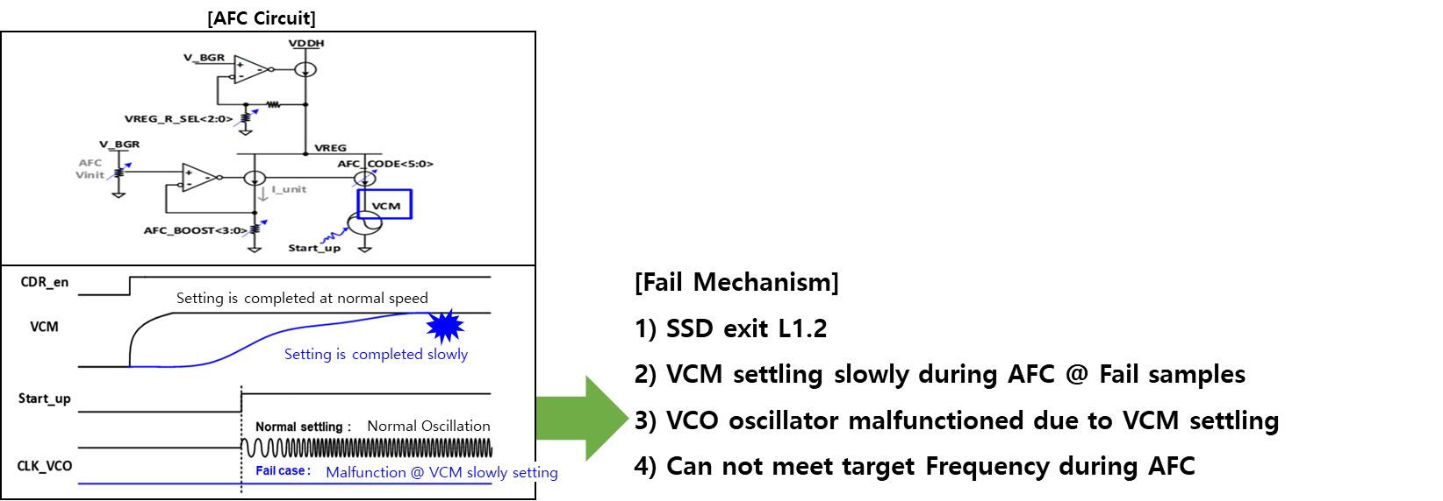
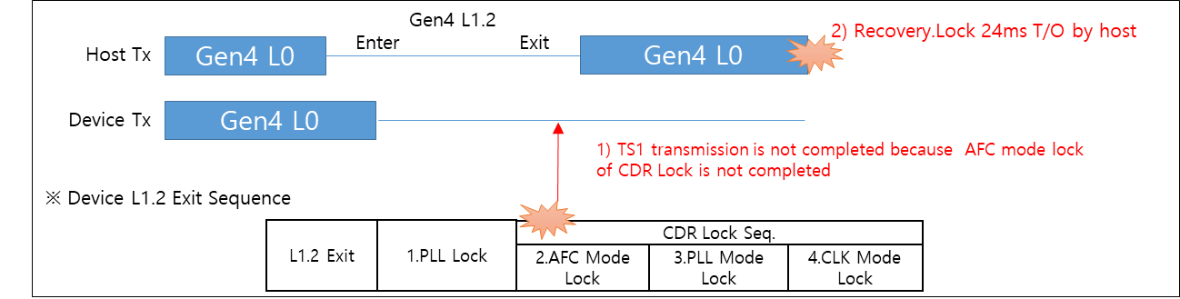
(2nd item) Detailed of Change
Issue
Found Recovery.Lock 24ms Timeout when exit L1.2 during Modern standby testing
Root cause (failure mechanism)
Device couldn’t send TS1 (training Sequence 1) to Host and finally Recovery.Lock 24ms Timeout occurred and Link down happened
When exit L1.2, CDR (Clock and Data Recovery) Lock of CTRL is not properly completed [Fig 1]
The slow completion of VCM(Reference voltage of VCO in AFC circuit) settling was observed with very low probability during the AFC Sequence
VCO(Clock oscillation circuit) malfunctioned due to the slow completion of VCM settling at fail samples
[Fig 1]
[Fig 2]

Slide 8
(2nd item) Detailed of Change
Corrective action
Improvement Action
Team added W/A point to improve AFC circuit malfunction
Add 2 times AFC circuit retry code when AFC circuit work abnormally
So, If AFC circuit work abnormally, the FW initializes AFC circuit after 10ms and 15ms
1) 1st AFC retry with AFC circuit initiate after 10ms
2) 2nd AFC retry with AFC circuit initiate after 15ms
L1.2 Exit | 1. AFC | 2. Freq. Coarse Lock | 3. Freq. Fine Lock | 4. Phase Coarse Lock | 5. Phase Fine Lock
[ AFC Retry code – 2 times ]

Slide 9
(3rd item) Detailed of Change
Issue
SW encryption time takes so long
Root cause
It is related to side effect from previous Change item( Unmap process optimization )
Splitting # of LPN per Unmap Range was essential to guarantee to enter PM, but # was excessively small @ GXA7602Q
FW handling time for Unmap are lengthened ➔ Free Blocks are generated more slowly
→ Ratio of unnecessary Migration & TLC write is increased
Corrective action
# of LPN per Unmap Range needs change : Total # of LPN per Device (GXA7402Q) -> 1000 (GXA7602Q) -> 10000 (GXA7702Q)
GXA7402Q
GXA7602Q
GXA7702Q
Unmap Range # = 1
# of LPN per Range = # of Total LPN
Unmap Range # = N
# of LPN per Range = 1000
Unmap Range # = N/10
# of LPN per Range = 10000
LPN 0
End LPN
LPN 0
End LPN
LPN 0
End LPN
① 1st idle time -> BG unmap
① 1st idle time -> BG unmap
① 1st idle time -> BG unmap
② New small range trim to head LPN
② New small range trim to head LPN
② New small range trim to head LPN
③ 2nd idle time -> BG unmap
③ 2nd idle time -> BG unmap
③ 2nd idle time -> BG unmap

Slide 10
(4rd item) Detailed of Change
Issue
Seq Write performance was dropped after long idle
Root cause
In DSB Off state, Foreground SSB Compaction( a kind of garbage collection) is executed to receive all write data from CDM to SSB as SLC area.
FW checks the existence of the target block for F/G SSB Compaction in the process of checking whether there is a target SSB to perform F/G SSB Compaction after Exit PM – ( Select list for Victim block)
But FW removed the target block checked from the Compaction Victim List.
SSB Free block cannot be created because the target block is not selected as Victim of F/G SSB Compaction,
Finally, TLC write occurred because SSB doesn’t have a room for write during CDM and Seq write performance showed TLC performance
Corrective action
When exit PM( power management mode), FW only check whether the F/G SSB Compaction Victim exists and do not remove it from the list.
Only Need to Check
But, Also the block is removed from list
F/G SSB Compaction Victim List
Invalid data
SSB
SSB
SSB
SSB
VPC ≤ 10%
While Processing Exit PM,
Check Whether F/G SSB Compaction Victim Exist
※ DSB Off Condition && VPC ≤ 10%

Slide 11
(5th item) Detailed of Change
Issue
LTR Latency value Register was reversed
Root cause
Register mapping related to Snoop/No-snoop latency of device FW Header was reversed.
Corrective action
Header file of Device FW is fixed.

